Slide 1
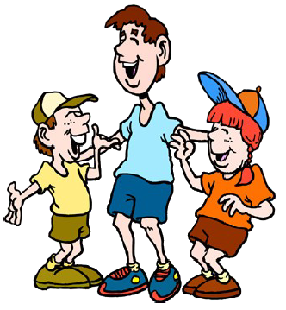
This product is meant for use in any classroom in which it will enrich the learning and the lives of children and may be freely shared among educators.
Thank you for downloading this item.
If you like this, or any of my other products, please leave some feedback for me.
http://www.teacherspayteachers.com/Store/Jennifer-Glueck
This product is not meant to be reproduced and/or sold in whole or
in part without the permission of the author, please contact me for further information.
Jennifer Glueck
Madison Elementary School District
Phoenix, Arizona, U.S.A.
jglueck@msd38.org

Slide 2
Objective: Given sentences with unfamiliar words, YWBAT use context clues to determine the meaning of the unfamiliar words.
CCELAS.1.RF.4c & ELL II.R.2.15
Unfamiliar Words
Words that you can read, but you don't know what they mean...
the word is not in your vocabulary
skritz
zillow
yuzz
lerkim
wocket
zax

Slide 3
Objective: Given sentences with unfamiliar words, YWBAT use context clues to determine the meaning of the unfamiliar words.
CCELAS.1.RF.4c & ELL II.R.2.15
prohibited
Now let's read the word in the sentence and look for context clues...
The sign in the library says that shouting is prohibited.

Slide 4
What do I know about the other words in the sentence?
The sign in the library says that shouting is prohibited.
I know that a library is a quiet place for reading books.
I know that shouting means to talk really LOUD!

Slide 5
Now, I can use what I know to make a good guess about the meaning of the unfamiliar word!
I know that talking loudly is NOT allowed in the library,
so something that is
prohibited
must be something that we are not allowed to do!

Slide 6
Let's reread the sentence and see if our guess makes sense...
The sign in the library says that shouting is not allowed.
Does it make sense?

Slide 7
Yes, it makes sense!

Slide 8
Remember:
If it doesn't make sense... don't continue the rest of the story! You won't understand it.

Slide 9
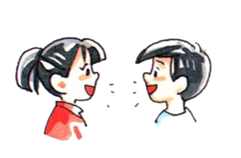
Objective: Given sentences with unfamiliar words, YWBAT use context clues to determine the meaning of the unfamiliar words.
CCELAS.1.RF.4c & ELL II.R.2.15
Let's try another one...
pounced
Now let's read the word in the sentence and look for context clues...
The cat ran after the mouse and pounced on it.
Talk to your partner…

Slide 10
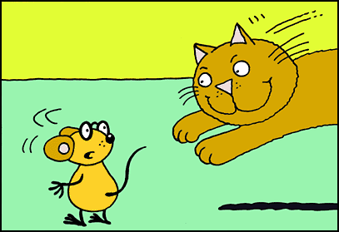
What do I know about the other words in the sentence?
The cat ran after the mouse and pounced on it.
I know that cats like to chase mice.
When they get close enough, they usually jump on top of them to catch them.

Slide 11
Now, I can use what I know to make a good guess about the meaning of the unfamiliar word!
I know that cats like to jump on top of mice to catch them,
pounce
must mean to jump on top of something!

Slide 12
Let's reread the sentence and see if our guess makes sense...
The cat ran after the mouse and jumped on it.
Does it make sense?

Slide 13
Yes, it makes sense!

Slide 14
Remember:
If it doesn't make sense...don't continue the rest of the story! You won't understand it.

Slide 15
So remember, when you're reading:
1) Read the whole sentence.
2) Use what you know about other words to get a clue!
3) Ask "Does it Make Sense?"
4) Go back and Reread!
Now you try it!
Good Luck!

